Slide 1
AUTOMATIC WATER LEVEL INDICATOR AND CONTROLLER USING ARDUINO

Slide 2
Abstract
Most of the people in residential areas face the problem of running out of water and overflow of water in water tanks due to excess supply of water. It becomes difficult for users to judge the level of water in water tanks. When the pump is turned ON, users will not realize that the water tank is filled, which may result in overflow. Water level indicator and controller system is used to sort out the issues associated with water tank. It is also possible to check the level of the water using sensor so that whenever the water goes below, pump gets turned ON automatically. Also when there is overflow of water in water tank it uses sensor to detect the water level so that if the water level goes above, the pump gets turned off automatically. This system prevents wastage of water

Slide 3
INTRODUCTION
Water is essential in every hour of our lives. Hardly anyone keeps in track of the level of water in the overhead tanks. Consequently, automatic controlling involves designing a control system to function with minimal or no human interference. The idea can be implicitly used to ascertain and control the level of water in overhead tanks and prevent the wastage. In this Arduino based automatic water level indicator and controller project, the water level is being measured by using ultrasonic sensors. The objective of the project is to measure the level of water in the tank and notify the user about the water level.

Slide 4
EXISTING METHODS
At present, water meters are used to calculate the amount of water used at homes. This doesn’t provide an efficient method of monitoring the water usage. The water is wasted at each and every outlet knowingly or unknowingly which adds up to huge amount in the end. Efficient management of the water used at homes is very much necessary as, about 50% of water supplied to the cities gets wasted through its improper usage. Water management is only possible, if the user is aware of the quantity of water he uses and the quantity available to him

Slide 5
PROPOSED METHOD
This proposed system works under automation and contains the components like Arduino ,ultrasonic sensor, motor pump, relay, led, buzzer and LCD in which each component has its own functionality but Arduino looks like heart of the project as all the components are interfaced with Arduino.
The ultrasonic sensor plays major role in determining the water level present in the tank. This sensor is fitted under the lid of the tank and uses the concept called „echo‟.
The sensor contains two small openings called trig and echo.
The trig works like a small speaker in which it sends the ultrasonic waves and the echo acts as a small microphone in which it receives the reflected waves which are sent by trig and this echo returns the distance.
So by this we are known of water level in the tank through LCD.
Another advantage of this proposed system is motor automation.
We have designed a code that whenever the tank is getting low about of 10% the motor automatically starts and stops when the tank reaches to 90% so here no one required for controlling to motor this is the main advantage of proposed system. Since no component touches the water there is no chance of damage to the components whereas in the existing system contains wires that are placed in water which may cause damage.

Slide 6
BLOCK DIAGRAM
POWER SUPPLY
ARDUINO UNO
RELAY
WATER MOTOR
ULTRASONIC SENSOR
LCD

Slide 7
HARDWARE REQUIREMENTS
ARDUINO UNO
ULTRASONIC SENSOR
RELAY
WATER MOTOR

Slide 8
SOFTWARE REQUIREMENTS
ARDUINO IDE
C LANGUAGE

Slide 9
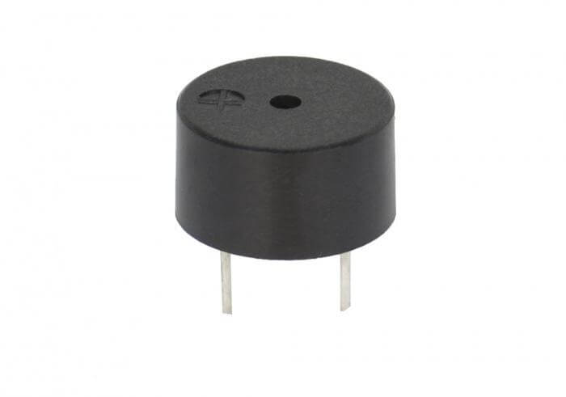
BUZZER
A buzzer or beeper is a signaling device, usually electronic, typically used in automobiles, household appliances such as a microwave oven, or game shows.
It most commonly consists of a number of switches or sensors connected to a control unit that determines if and which button was pushed or a preset time has lapsed, and usually illuminates a light on the appropriate button or control panel, and sounds a warning in the form of a continuous or intermittent buzzing or beeping sound.

Slide 10
LCD
A liquid crystal display (LCD) is a thin, flat display device made up of any number of color or monochrome pixels arrayed in front of a light source or reflector.
Each pixel consists of a column of liquid crystal molecules suspended between two transparent electrodes, and two polarizing filters, the axes of polarity of which are perpendicular to each other. Without the liquid crystals between them, light passing through one would be blocked by the other.
The liquid crystal twists the polarization of light entering one filter to allow it to pass through the other.
A program must interact with the outside world using input and output devices that communicate directly with a human being. One of the most common devices attached to an controller is an LCD display.

Slide 11
FEATURES:
The operating voltage of this LCD is 4.7V-5.3V
It includes two rows where each row can produce 16-characters.
The utilization of current is 1mA with no backlight
Every character can be built with a 5×8 pixel box
The alphanumeric LCDs alphabets & numbers
Is display can work on two modes like 4-bit & 8-bit
These are obtainable in Blue & Green Backlight
It displays a few custom generated characters

Slide 12
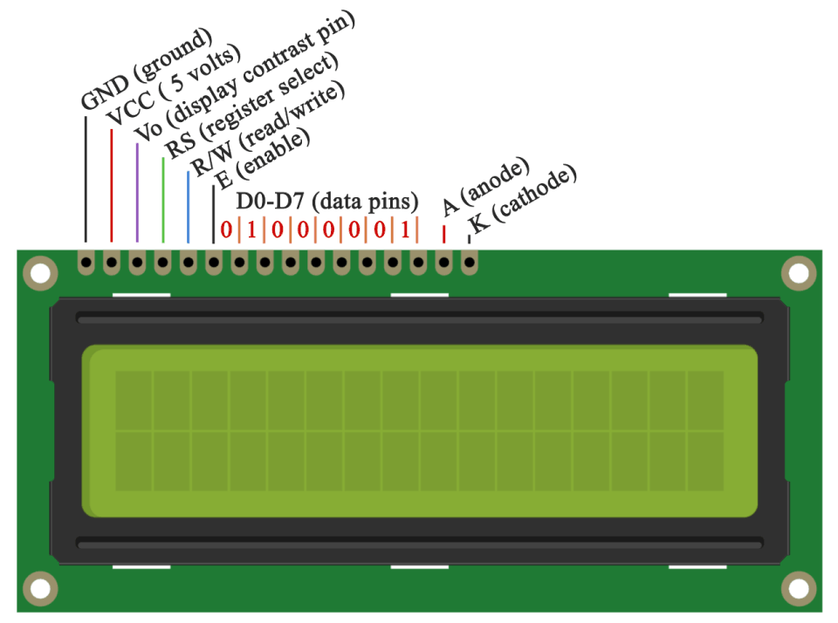
PIN DESCRIPTION

Slide 13
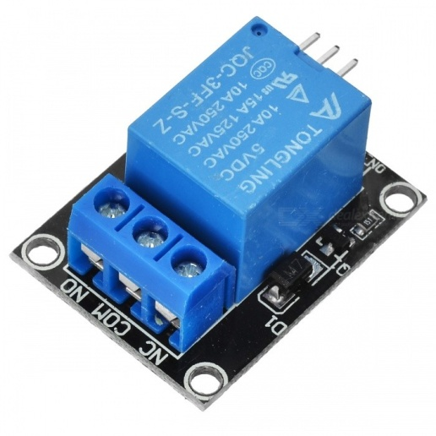
RELAY
A relay is an electrical switch that opens and closes under the control of another electrical circuit.
In the original form, the switch is operated by an electromagnet to open or close one or many sets of contacts.
A relay is able to control an output circuit of higher power than the input circuit, it can be considered to be, in a broad sense, a form of an electrical amplifier.

Slide 14
ULTRASONIC SENSOR
An Ultrasonic sensor is a device that can measure the distance to an object by using sound waves.
It measures distance by sending out a sound wave at a specific frequency and listening for that sound wave to bounce back.
By recording the elapsed time between the sound wave being generated and the sound wave bouncing back, it is possible to calculate the distance between the sonar sensor and the object.

Slide 15
FEATURES
Ultrasonic ranging module HC - SR04 provides
2cm - 400cm non-contact measurement function,
the ranging accuracy can reach to 3mm
The basic principle of work:
(1) Using IO trigger for at least 10us high level signal.
(2) The Module automatically sends eight 40 kHz and detect whether there is a pulse signal back.
(3) IF the signal back, through high level , time of high output IO duration is the time from sending ultrasonic to returning.

Slide 16
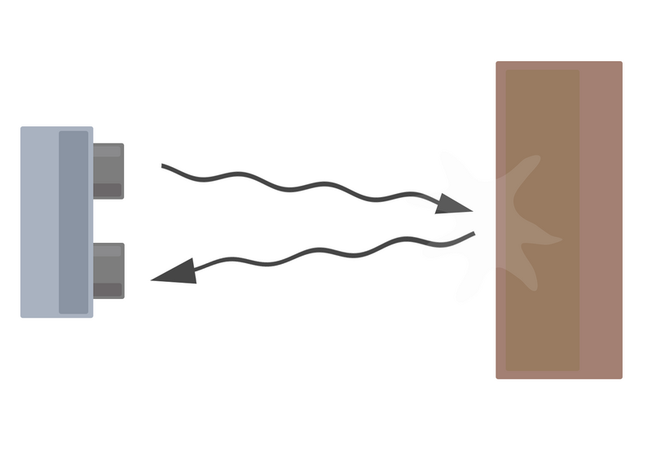
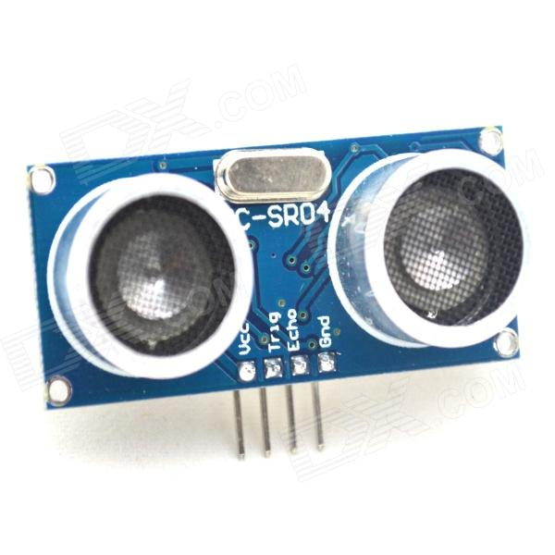

Slide 17
AURDINO CONTROLLER
The Arduino Uno is a microcontroller board based on the ATmega328. It has 14 digital input/output pins (of which 6 can be used as PWM outputs), 6 analog inputs, a 16 MHz ceramic resonator, a USB connection, a power jack, an ICSP header, and a reset button.
It contains everything needed to support the microcontroller; simply connect it to a computer with a USB cable or power it with a AC-to-DC adapter or battery to get started.
The Uno differs from all preceding boards in that it does not use the FTDI USB-to-serial driver chip. Instead, it features the Atmega16U2 (Atmega8U2 up to version R2) programmed as a USB-to-serial converter

Slide 18
SPECIFICATIONS
Microcontroller : ATmega328
Operating Voltage: 5V
Input Voltage (recommended): 7-12V
Input Voltage (limits): 6-20V
Digital I/O Pins : 14 (of which 6 provide PWM output)
Analog Input Pins : 6
DC Current per I/O Pin :40 mA
DC Current for 3.3V Pin :50 mA
Flash Memory 32 KB (ATmega328) of which 0.5 KB used by bootloader
SRAM 2 KB (ATmega328)
EEPROM 1 KB (ATmega328)
Clock Speed 16 MHz

Slide 19
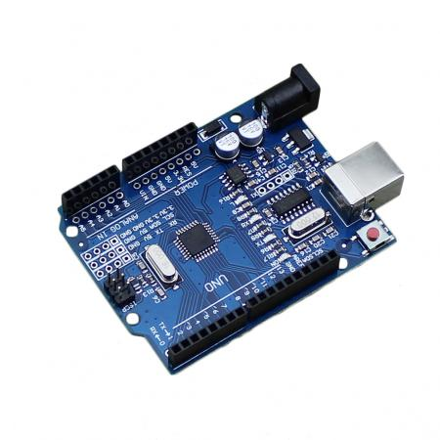

Slide 20
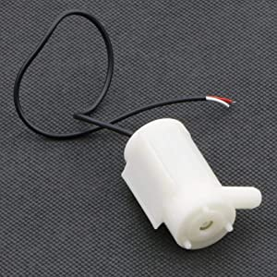
DC WATER MOTOR
This DC 3-6 V Mini Micro Submersible Water Pump is a low cost, small size Submersible Pump Motor which can be operated from a 2.5 ~ 6V power supply.
It can take up to 120 liters per hour with a very low current consumption of 220mA. Just connect tube pipe to the motor outlet, submerge it in water and power it.

Slide 21
SPECIFICATIONS
Operating Voltage(VDC) : 2.5 to 6 V
Operating Current (mA) : 130 to 220 mA
Flow Rate (L/H) : 80 to 120 Lit./h
Maximum Lift (mm) : 40 to 110 mm
Continuous Working Life (hours) : 500
Driving Mode : DC, Magnetic Driving
Material : Plastic
Outlet Outside / Inside Diameter (mm) : 7.5 mm / 5 mm

